Slide 1


IMDb Reviews Analysis
Make the most from user reviews
Nir Shelly & Shani Noy
October 2020

Slide 2
Main things we did and challenges
Analyzing the text:
Test if there are NA
Test if data is balanced
Explore our text: are there special characters (as <br \>), length of text
Which tokenizer to use (word_tokenize / RegexpTokenizer from nltk)
NLP Task – sentiment analysis : we cannot use general tokenizers as spacy etc.

Slide 3
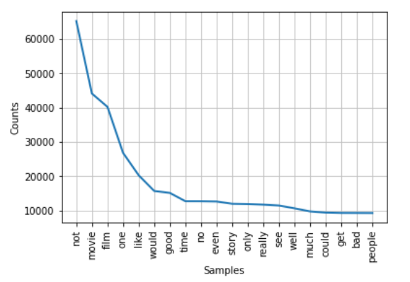
Main things we did and challenges
Analyzing the text:
Which words are most used (after we preprcossed the text)

Slide 4
Main things we did and challenges
Preprocessing the text
Creating a function to preprocess (see clean_reviews function)

Slide 5
Main things we did and challenges
Embedding
Word2Vec (Dov2Vec)
Word2Vec Trains a unique word embedding for every individual word
FastText
Fasttext treats each word as the aggregation of its subwords (subwords are taken to be the character ngrams of the word). The vector for a word is simply taken to be the sum of all vectors of its component char-ngrams
Better for morphologically rich languages (Hebrew,German, Turkish etc)
fastText can obtain vectors even for out-of-vocabulary (OOV) words, by summing up vectors for its component char-ngrams, provided at least one of the char-ngrams was present in the training data.

Slide 6
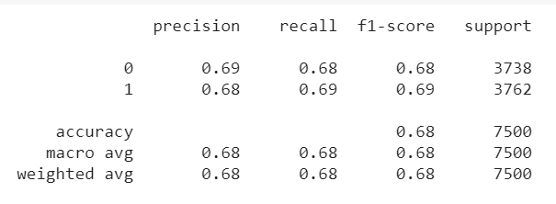
Main things we did and challenges
Classification of reviews (supervised model)
Running Doc2Vec and using DecisionTreeClassifier

Slide 7
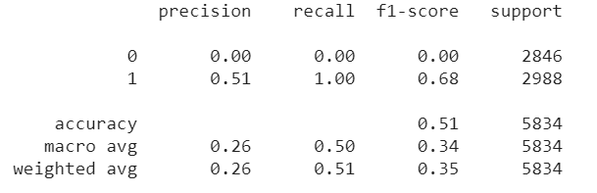
Main things we did and challenges
Classification of reviews (supervised model)
Running Word2Vec and using DecisionTreeClassifier

Slide 8
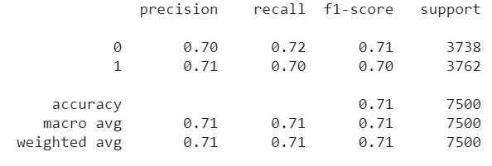
Main things we did and challenges
Classification of reviews (supervised model)
Running Dord2Vec and using DecisionTreeClassifier , and building model from training dataset only (model.build_vocab(train_corpus))
Vector size = 50
DecisionTree Model

Slide 9
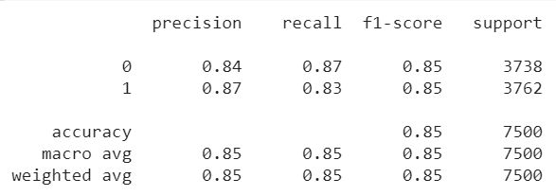
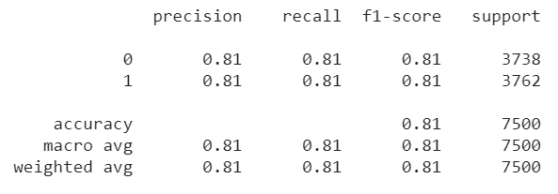
Main things we did and challenges
Classification of reviews (supervised model)
..continue
SVM Model – vector size=50 and 200 (200 gave 0.83 in precision 0)
RandomForest Model

Slide 10
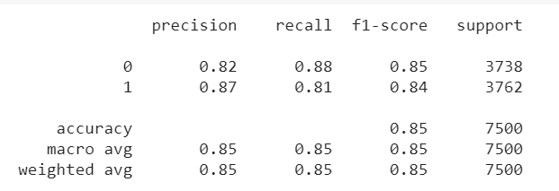
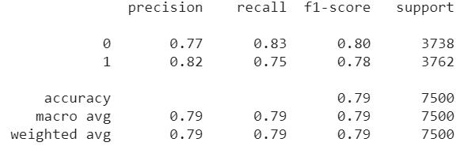
Main things we did and challenges
Classification of reviews (supervised model)
..continue
Logistic Regression Model
Naive Base Model

Slide 11
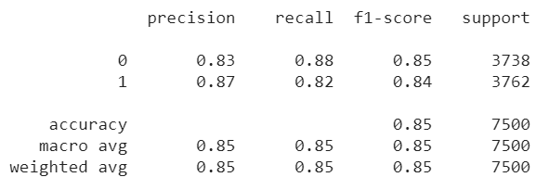
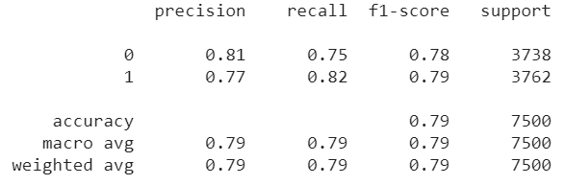
Main things we did and challenges
Classification of reviews (supervised model)
..continue
LinearSVC Model
KNN Model (k=7)

Slide 12



Main things we did and challenges
Classification of reviews (supervised model)
Using Fasttext from command-line, without ability to choose Model
FastText
FastText with cleaned text
FastText with cleaned text and learning rate=0.05, epochs=30

Slide 13
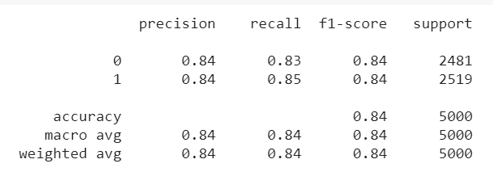
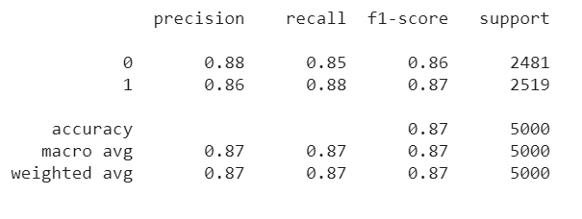
Main things we did and challenges
Classification of reviews (supervised model)
Loading FastText model and using it with different algorithms
FastText with cleaned text- SVM
FastText with cleaned text- Logistic Regression

Slide 14
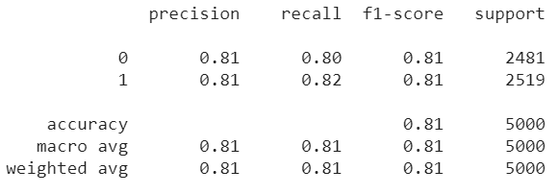
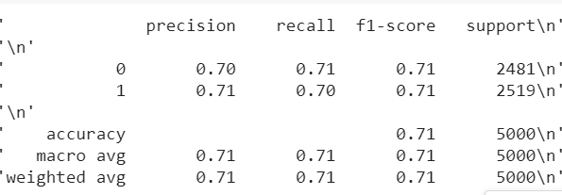
Main things we did and challenges
Classification of reviews (supervised model)
…continue
FastText with cleaned text- Random Forest
FastText with cleaned text- Decision Tree

Slide 15
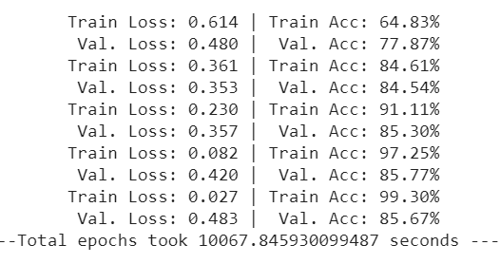
Main things we did and challenges
Classification of reviews (supervised model)
Using NN and LSTM
Predict on several reviews from test file, worked well.
Why NN worked better than ML? ML worked on binary classification, but as we see there are reviews which are not totally bad and not totally good, thus giving 0 or 1 can be misleading. However, in NN we got probability which enables us to work better with our data, such that when given new review, we will classify as “positive” only if its score is close enough to a value we decide.

Slide 16
Main things we did and challenges
Classification of reviews (supervised model)
Using NN and LSTM – a second run
We made a second run , with embedding of 300 vectors (embedding with fasttext vector for some reason did not work)
We added precision and recall scores and got very good scores.
We tested on several reviews, and got very good results.
This is the best model so far

Slide 17

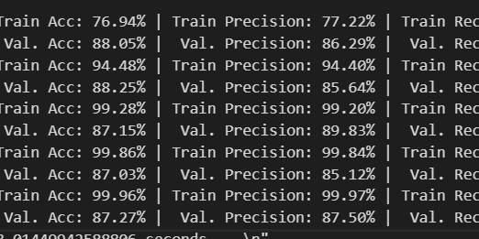
Main things we did and challenges
Classification of reviews (supervised model)
Using NN and GRU – a third run
Got better results than LSTM , but on predict got worser results

Slide 18
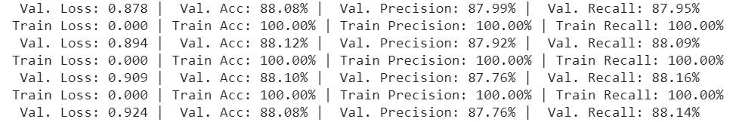
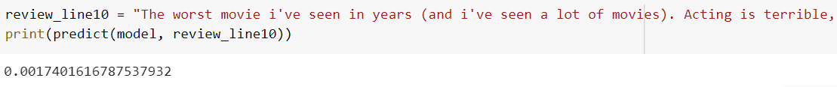
Main things we did and challenges
Classification of reviews (supervised model)
Using NN and GRU – Now running with 20 epochs and got the best results ever

Slide 19
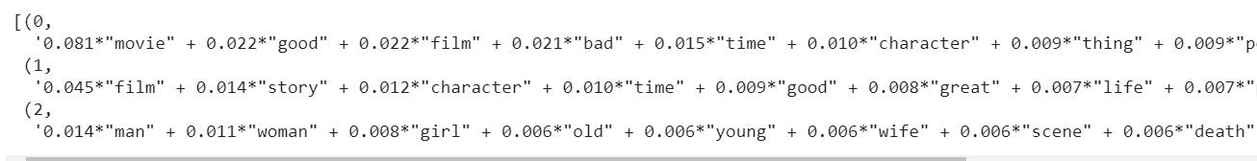
Main things we did and challenges
Topic Modelling
We made topic modelling with 3 topics but did not get good results.
One topic was on film
The order on movie
And the third with man, woman ,girl, old, etc .

Slide 20
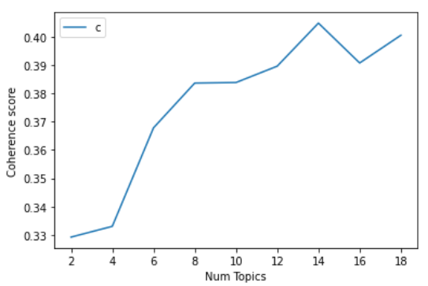
Main things we did and challenges
Topic Modelling
We made a second try, dropping film, movie words.
Not good ,since there are also reviews on episodes etc. So maybe topic modelling will be one films and episodes etc.
So a third try (keep orig stopwords):
Make graph score as a function of num of topics
The best score was for 14 topics

Slide 21
Main things we did and challenges
(1,
[('great', 0.04810005310895667),
('music', 0.03004300784138125),
('version', 0.023013881223380436),
('good', 0.016536671213904133),
('time', 0.016255506149184102),
('star', 0.01500588363931729),
('wonderful', 0.014985056597486175),
('year', 0.014943402513823948),
('number', 0.014370658863468328),
('song', 0.014027012673254954)]),
(6,
[('scene', 0.03321999723249056),
('guy', 0.02616284816257141),
('woman', 0.017721944373060274),
('sex', 0.015537588708561489),
('girl', 0.014648032103109495),
('death', 0.014262557574080298),
('car', 0.014203253800383498),
('killer', 0.014203253800383498),
('night', 0.01233518492893431),
('head', 0.011840986814794315)]),
(11,
[('scene', 0.05976507172447578),
('action', 0.037007060627682345),
('black', 0.01966965208038253),
('art', 0.015101010638864336),
('sequence', 0.014131904878542295),
('hero', 0.011810310859309272),
('style', 0.011597320582315418),
('time', 0.009861449824815497),
('point', 0.009776253714017955),
('slow', 0.009765604200168263)]),
Musical
Death and killing
Action

Slide 22
Main things we did and challenges
Topic Modelling – getting 14 topics
(8,
[('film', 0.4150432678505516),
('director', 0.03753639831029816),
('camera', 0.01416970840339581),
('work', 0.013298199565270886),
('minute', 0.011114300947381372),
('audience', 0.010601648689660828),
('shot', 0.009904441619160891),
('scene', 0.00964811549030062),
('time', 0.009217487593815363),
('cinema', 0.008551039658778656)]),
(5,
[('bad', 0.09762325867927903),
('horror', 0.030106714890403608),
('effect', 0.027473619363685142),
('low', 0.019504779316786233),
('plot', 0.018848989487490312),
('budget', 0.01745792015262018),
('awful', 0.01646429919914151),
('special', 0.016394745732398006),
('terrible', 0.014755271159158204),
('stupid', 0.013384074243357644)]),
(3,
[('life', 0.043484419263456094),
('young', 0.04026709834075273),
('family', 0.033903278025091056),
('friend', 0.027974504249291786),
('child', 0.027610279239174425),
('woman', 0.027013354917037637),
('love', 0.026375961149332255),
('kid', 0.026345609065155807),
('girl', 0.02285511938486443),
('boy', 0.019789558883043304)]),
Directors
Horror
Family

Slide 23
Main things we did and challenges
Topic Modelling – getting 14 topics
(10,
[('performance', 0.03530586137385641),
('story', 0.02670956737478679),
('book', 0.02293960303923089),
('role', 0.01312218948674213),
('drama', 0.012812063885873779),
('character', 0.011290510156613429),
('strong', 0.010631493254768181),
('viewer', 0.010059699178167158),
('work', 0.00969142502713599),
('brilliant', 0.009148705225616375)]),
(9,
[('good', 0.049701941482089146),
('funny', 0.04608148755810774),
('actor', 0.03541700847689363),
('comedy', 0.03476073284112661),
('line', 0.0246322121957889),
('fun', 0.02306808859721083),
('humor', 0.018714793546622914),
('script', 0.017828821438337434),
('part', 0.01742411812961444),
('joke', 0.01332239540607055)]),
(13,
[('people', 0.03337990698030509),
('life', 0.015407583210519264),
('war', 0.014737688288322774),
('history', 0.012536604972534308),
('american', 0.012105958236836564),
('point', 0.011397783604800276),
('world', 0.010814018029743334),
('documentary', 0.009981434340727697),
('event', 0.009646486879629452),
('country', 0.00917756043409191)]),
Performance
Funny and comedy
History

Slide 24
Main things we did and challenges
Topic Modelling – getting 14 topics
(0,
[('movie', 0.5241227369967113),
('people', 0.03708079227731835),
('bad', 0.032812882488798066),
('time', 0.02650148472173441),
('good', 0.02611833072575753),
('watch', 0.014964292176208266),
('thing', 0.012495077535468352),
('money', 0.011377545047202444),
('waste', 0.010462232723479889),
('theater', 0.010323871558266015)
Time on watching

